Slide 1
A
Assumption High School
10th Grade Parent Information
Class of 2023

Slide 2
Topics
Graduation Pathways/Requirements
TOPS
Grade Promotion
Testing
Sophomore Individual Planning
Academic institution promoting High expectations resulting in Successful students
Assumption High School

Slide 3
Louisiana High School Graduation Requirements
Identifying an appropriate individualized student graduation pathway is a critical step at the end of the 10th grade year. Students can participate in one or both pathways, TOPS University or Jump Start TOPS Tech. Both pathways help students prepare for postsecondary success and gain access to scholarships.
Students selecting the TOPS University Pathway will continue to pursue core academic credits that mirror the TOPS Core curriculum. Students planning on attending a 4-year college or University should pursue the TOPS University Pathway. Students graduating on the TOPS University Pathway may also complete Jump Start courses as electives and earn an industry credential.
Students pursuing the Jump Start TOPS Tech Pathway may earn basic or advanced credentials in statewide or regional career areas. Students planning on attending a 2-year community college, technical school, vo-tech program, or enter the workforce should pursue the Jump Start TOPS Tech Pathway. Students graduating with a Jump Start TOPS Tech Career Diploma will be required to attain Jump Start statewide or regional credentials. Through elective coursework students may also earn the TOPS University credential.
Academic institution promoting High expectations resulting in Successful students
Assumption High School

Slide 4
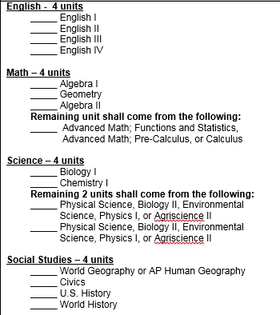
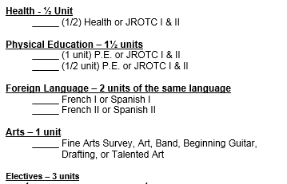
TOPS University Diploma (Required for admission into a 4-year University)
Academic institution promoting High expectations resulting in Successful students
Assumption High School

Slide 5
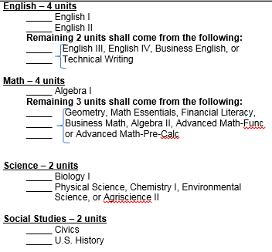
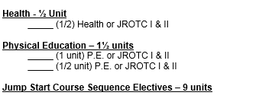
Jumpstart TOPS Tech Diploma
Academic institution promoting High expectations resulting in Successful students
**Reminder: This pathway will allow students to enter into a 2 year community college or vocational program. Upon achieving an approved Associate’s Degree, the student can then enter into a 4 Year University. **
Assumption High School

Slide 6
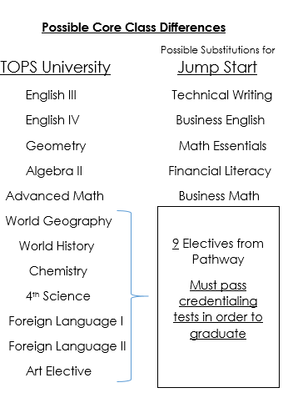
Academic institution promoting High expectations resulting in Successful students
Assumption High School

Slide 7
AHS Jumpstart Career Pathways
Manufacturing, Construction, Crafts, Logistics:
Carpenter
Electrician
Welder
Certified Nursing Assistant
Hospitality, Tourism, Culinary, and Retail
Business Management
Public Service
Academic institution promoting High expectations resulting in Successful students
Assumption High School

Slide 8
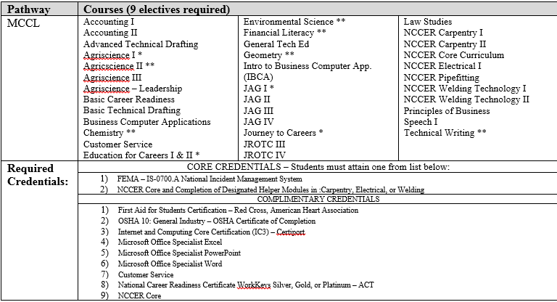
AHS Jumpstart Career Pathways
Academic institution promoting High expectations resulting in Successful students
Assumption High School

Slide 9
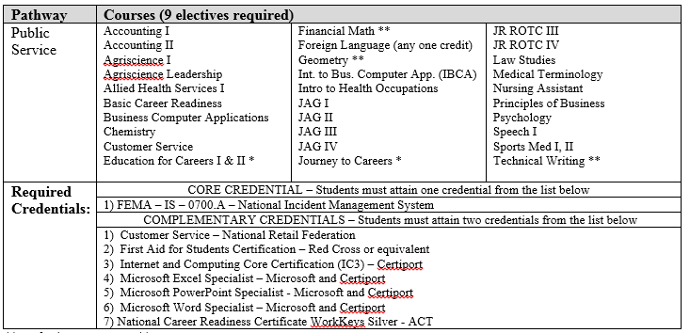
AHS Jumpstart Career Pathways
Academic institution promoting High expectations resulting in Successful students
Assumption High School

Slide 10
Jumpstart Credentials
Along with passing the 23 credits required for graduation on Jumpstart, the student must pass a series of credentialing tests.
Examples include FEMA, NCCER Core, Customer Service, Microsoft Specialists, Servsafe, SP2, NCCER Helpers, NCCER Levels I and II, OSHA 10, and WorkKeys.
Specific tests required for each pathway will be discussed once a student determines a pathway.
Academic institution promoting High expectations resulting in Successful students
Assumption High School

Slide 11
TOPS
The TOPS University Diploma requirements also fulfill the core curriculum requirements for the TOPS award!
TOPS is a scholarship that pays for college tuition and can be used at any public University in the state of Louisiana for up to 4 years (8 semesters). The TOPS scholarship can also be used to pay a portion of tuition at private/independent colleges and universities in the state of Louisiana.
Academic institution promoting High expectations resulting in Successful students
There are 3 different award levels of TOPS based on student achievement:
OPPORTUNITY:
Core course GPA : 2.5
ACT score : 20+
(basic tuition)
PERFORMANCE:
Core course GPA : 3.25
ACT score : 23+
(basic tuition + $400/year stipend)
HONORS:
Core course GPA : 3.5
ACT score : 27+
(basic tuition + $800/year stipend)
**For the most up to date information on TOPS funding and legislative updates, visit www.osfa.state.la.us/ **
Assumption High School

Slide 12
TOPS Tech
The Jumpstart TOPS Tech Diploma requirements also fulfill the core curriculum requirements for the TOPS Tech award!
(TOPS University Diploma requirements can also be used to fulfill the requirements for the TOPS Tech award)
Academic institution promoting High expectations resulting in Successful students
TOPS Tech is a scholarship that pays for tuition for up to 2 years (4 semesters) at approved Louisiana Technical Schools, Community Colleges, and Proprietary Schools that offer technical (non-academic) programs.
Requirements:
Core GPA : 2.5
ACT : 17+ or WorkKeys Silver
**For updates regarding Jump Start and TOPS Tech, Text “JUMPSTART” to 99008**
Assumption High School

Slide 13
LEAP 2025 (Former End of Course Exam – EOC)
Along with completing either the TOPS University Diploma or the Jumpstart TOPS Tech Diploma, students must also pass LEAP Tests in order to graduate!
Students must pass 3 LEAP tests from the following (1 per category):
- English I or English II -
- Algebra I or Geometry -
Biology I or US History –
These tests will count as 20% of the final course grade.
Scores: Advanced (A), Mastery (B), Basic (C),
Approaching Basic (D), Unsatisfactory (F)
Academic institution promoting High expectations resulting in Successful students
Assumption High School

Slide 14
Grade Promotion
Students are promoted based on the number of units they earn each school year
Freshman: 0 – 5 units
Sophomore: 6 – 11 units
Junior: 12 – 17 units
Senior: 18+ units
*** Number of units alone does not indicate if a student is on track to graduate.***
Academic institution promoting High expectations resulting in Successful students
Assumption High School

Slide 15
Individual Planning
Twice a year (Fall/Spring)
Fall Meeting –
Give TOPS/College Information
Graduation Checklist/Transcript Review
Pathway Selection ---Parent must sign Jump Start Participation Form to transition to JumpStart
Preliminary Scheduling for 21-22
Spring Meeting-
Revisit 21-22 Schedule
Update Individual Graduation Plan
Must be signed by a parent
Academic institution promoting High expectations resulting in Successful students
Assumption High School

Slide 16
Support Contacts
Administrators
- Jessica Thibodeaux, Principal
jthibodeaux@assumptionschools.com
- Debby Landry, Assistant Principal
dlandry@assumptionschools.com
- Heath Zeringue, Assistant Principal
hzeringue@assumptionschools.com
AHS Guidance Website: ww.assumptionguidance.weebly.com
Counseling Department
- Alyssa Aysenne, A-D Counselor
aaysenne@assumptionschools.com
- Shannon Bayham, E-M Counselor
sbayham@assumptionschools.com
Erin Theriot, N-Z Counselor
etheriot@assumptionschools.com
Yvette Caballero – Secretary
ycaballero@assumptionschools.com
Academic institution promoting High expectations resulting in Successful students
Assumption High School

