Slide 1
A
Assumption High School
Freshman Roundup
Class of 2027

Slide 2
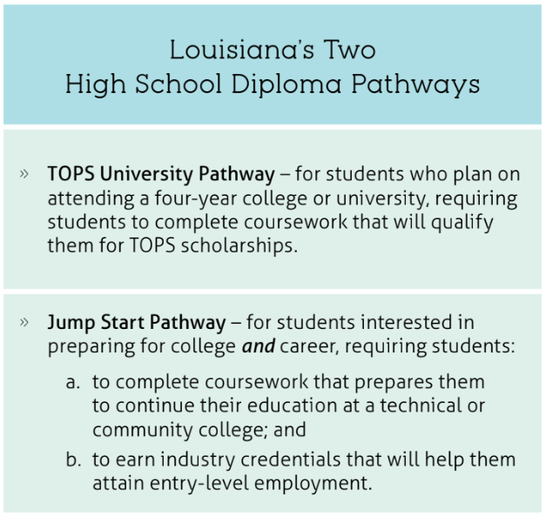
Louisiana High School Graduation Pathways Students enter high school following the TOPS University Pathway. Students wishing to switch to the Jump Start diploma must do so during their second year of high school.
Academic institution promoting High expectations resulting in Successful students
Assumption High School

Slide 3
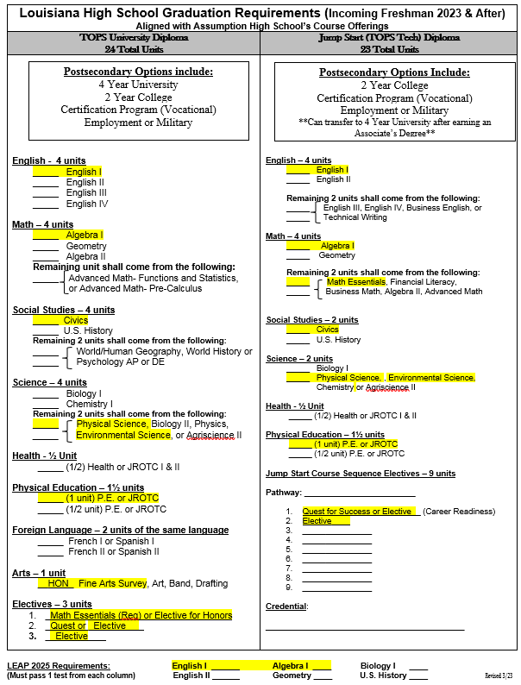
Academic institution promoting High expectations resulting in Successful students
Assumption High School

Slide 4
LEAP 2025 Exams
Along with completing either the TOPS University Diploma or the Jump Start TOPS Tech Diploma, students must also pass LEAP 2025 exams in order to graduate!
LEAP also factors into a student’s final grade in that course.
Students must pass 3 LEAP exams from the following
(1 from each category):
- English I or English II -
- Algebra I or Geometry -
Biology I or US History –
Achievement levels:
Passing: Advanced (A), Mastery (B), Basic (C) , Approaching Basic (D)
Not Passing: Unsatisfactory (F)
Academic institution promoting High expectations resulting in Successful students
Assumption High School

Slide 5
Grade Promotion
Students are promoted based on the number of units they earn each school year
Freshman: 0 – 5 units
Sophomore: 6 – 11 units
Junior: 12 – 17 units
Senior: 18+ units
Refer to the Parish Pupil Progression Plan yearly for the most accurate requirements.
*** Number of units alone does not indicate if a student is on track to graduate.***
Academic institution promoting High expectations resulting in Successful students
Assumption High School

Slide 6
Transcripts and Ranking
ALL courses taken for high school credit, including Edgenuity and those taken in middle school, will be on your official high school transcript!
Academic institution promoting High expectations resulting in Successful students
This can affect class ranking, GPA, TOPS & scholarship eligibility, awards, and college admission!
Assumption High School

Slide 7
Advanced Opportunities
Earn College Credits through
Dual Enrollment, AP, CLEP, & ACT
Industry Based Certifications (IBC’s)
Welding, Carpentry, CITF Core, OSHA- 10, MS Office Specialist,
Customer Service, Phlebotomy Tech, EKG Tech, Patient Care Technician (PCT)
$$$ Scholarships/ TOPS/ TOPS Tech $$$
Academic institution promoting High expectations resulting in Successful students
Assumption High School

Slide 8
Life at AHS
Mustang Life Slideshow
Academic institution promoting High expectations resulting in Successful students
Assumption High School

Slide 9
Registration Process
Students entering AHS from BRM, LMS, NMS, and PPE will automatically be transferred into our system. Folders and records will be sent to us directly from your school.
Any educational custody renewals need to be submitted to AHS before the first day of school.
8th grade students that successfully complete the 2022-2023 school year at BRM, LMS, NMS, and PPE are automatically AHS students. If a student is moving or transferring to a school other than AHS after the last day of school, drop paperwork must be completed at AHS.
Details on the registration process will be provided at the end of this presentation for all other students.
Academic institution promoting High expectations resulting in Successful students
Assumption High School

Slide 10
Completing the schedule proposal to choose 9th grade courses
Fill out your demographic information in section 1.
Indicate your interest in enrollment in honors classes. We will not place your child in honors, even if they qualify, if you do not check the course.
Choose between PE or ROTC for the Physical Education requirement.
Choose your electives. Review the course descriptions on the back of the schedule proposal to determine which electives you are interested in. NUMBER your choices 1, 2, 3 and 4. Number 1 should be your first choice, and will be the class that we will try our best to put in your 9th grade schedule!
Please let us know what diploma pathway you see your child pursuing.
Sign and date the bottom. DUE BY THURSDAY, APRIL 6, 2023!
RETURN OPTIONS:
BRM, LMS, NMS, & PPE students must turn proposals into their school office.
All other students will submit proposals with registration packets directly to the AHS guidance office.
Academic institution promoting High expectations resulting in Successful students
Assumption High School

Slide 11
Step 2: Honors Course Selection
Indicate your interest in enrollment in honors classes. We will not place your child in honors, even if they qualify, if you do not check the course.
Students can schedule Honors and Advanced Placement (AP) classes in the core subjects. Students qualify based on LEAP (public) or PreACT/TerraNova (non-public) scores in each core content area AND final course grades. These are the following guidelines according to pupil progression to qualify for honors and/or AP classes:
Advanced or Mastery on LEAP
AND
an A or B final class grade
Taking honors classes gives students extra points for class rank and for TOPS Core GPA.
See page 31 of the APSB Pupil Progression Plan for honors requirements and class rank policy.
Academic institution promoting High expectations resulting in Successful students
Assumption High School

Slide 12
Step 3: Physical Education Requirement- Choose PE or JROTC
PE
JROTC (Naval Science)
Academic institution promoting High expectations resulting in Successful students
Students participate in physical activity and learn the fundamentals of a variety of sports.
PE Uniforms are required. They will be ordered through the PE teacher at the beginning of each semester.
In class – PT , marching, team building.
Outside of class, students participate in parades and service activities.
Many leadership opportunities, color guard, rank, etc.
Uniforms are worn once per week to school and are provided by the school.
*Note: Athletes are placed in 4th Block PE/Conditioning at the request of the coach.
Assumption High School

Slide 13
JROTC offers many opportunities to get involved and become a leader at AHS.
Academic institution promoting High expectations resulting in Successful students
Assumption High School

Slide 14
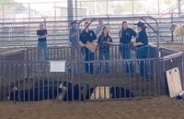
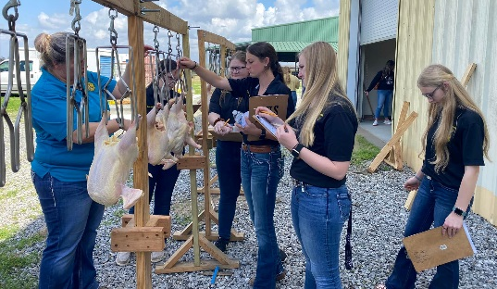
Step 4: Choose your electives - Ag
Agriscience - provides students with basic knowledge of agriculture and the science applications in agriculture. It includes units in animal science, plant science, agricultural mechanics (including hand woodworking, and small gas engines), and agricultural leadership. We offer Ag I, II, III, IV & Ag Leader!
Academic institution promoting High expectations resulting in Successful students
Students enrolled in Ag can become a member of the FFA.
Assumption High School

Slide 15
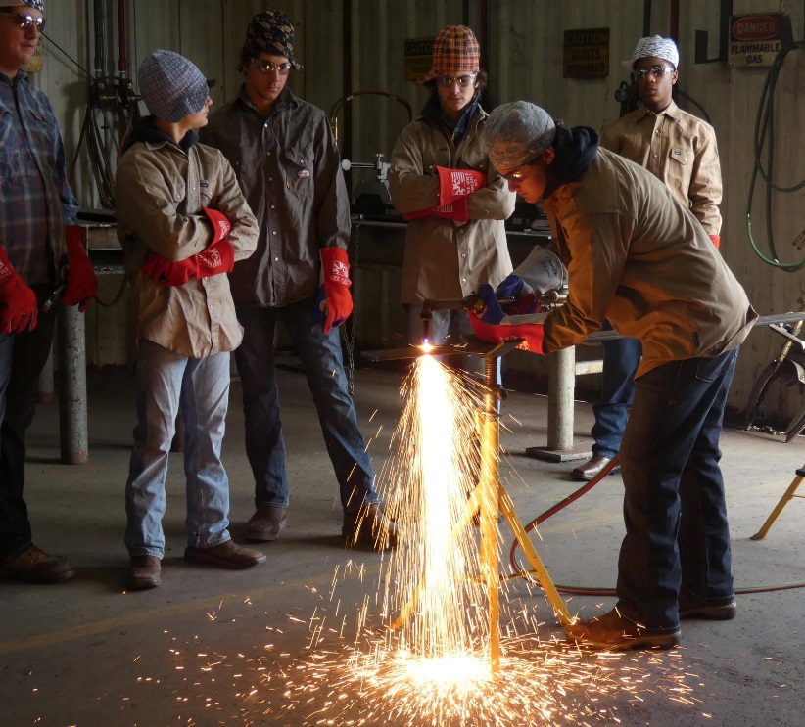
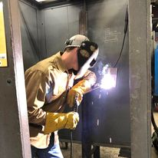
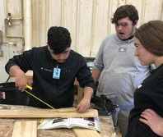
Step 4: Choose your electives - Ag
Ag I & Construction Math must be passed before taking Welding, Carpentry, or Pipefitting. If you will be interested in these classes later, choose Ag as an elective.
Academic institution promoting High expectations resulting in Successful students
Students have the opportunity to earn OSHA -10 in Ag I, and certify up to Level II in Welding and Carpentry.
Assumption High School

Slide 16
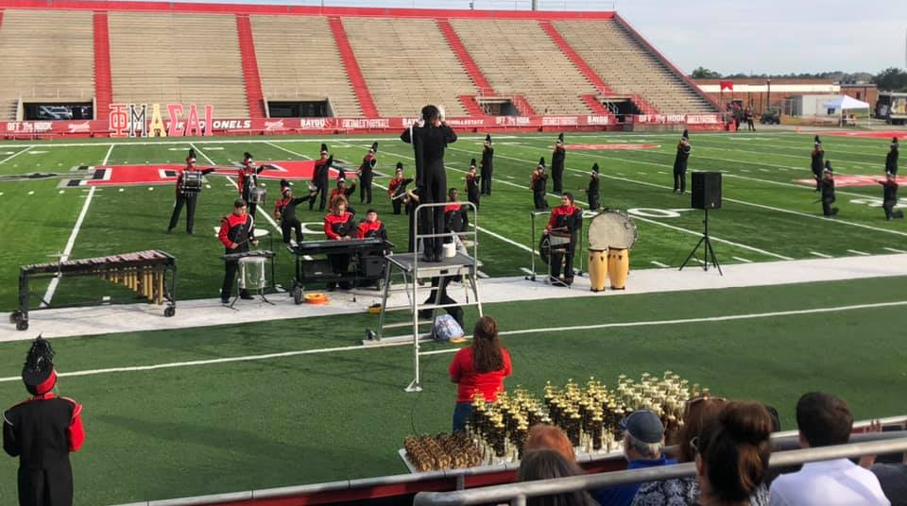
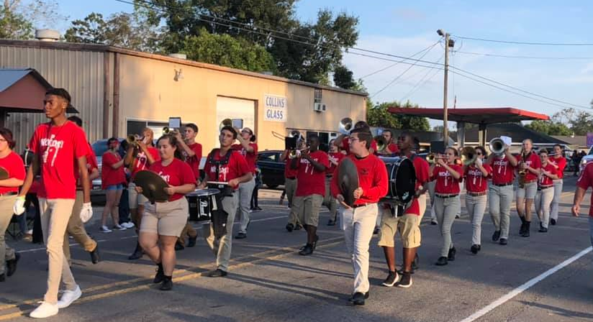
Step 4: Choose your electives- Band
Become a member of the Pride of Sugarland Band! Marching band members are required to attend summer camp. Band fulfills the Art graduation requirement.
Academic institution promoting High expectations resulting in Successful students
Assumption High School

Slide 17
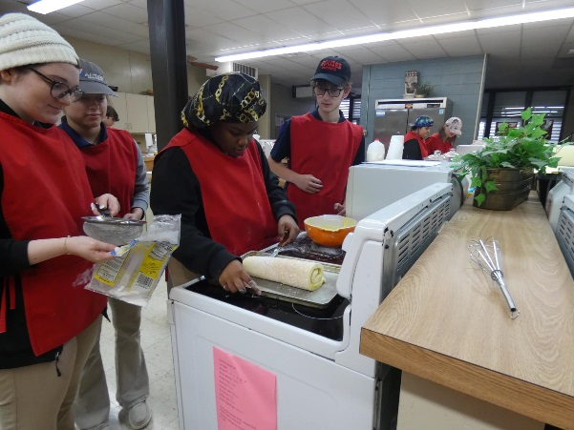
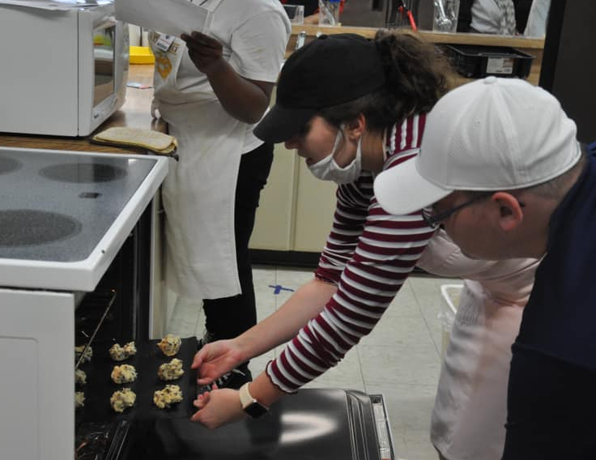
Step 4: Choose your electives- FACS
Family and Consumer Science focuses on the areas of personal and family living, wellness, nutrition and foods, financial management, living environments, appropriate child development practices, and transferring school skills to life and work. Students wanting to take Baking & Pastry Arts, Food & Nutrition, or FACS II in the future should choose this elective.
Academic institution promoting High expectations resulting in Successful students
Assumption High School

Slide 18
Step 4: Choose your electives- Foreign Language
2 units of the same foreign language are required to graduate on the TOPS University Pathway. These same languages can count as universal Jump Start electives. These classes are online and are only recommended for 9th grade students that have completed French I or Spanish I in middle school or are self motivated learners .
French I Spanish I
French II Spanish II
We also offer these classes through Dual Enrollment (College Level) for qualified students.
Dual Enrollment is normally recommended for students in 10th – 12th grade.
If you would like us to check on your child’s eligibility as a 9th grader, please email us.
Academic institution promoting High expectations resulting in Successful students
Assumption High School

Slide 19
Step 4: Choose your electives- IBCA
Introduction to Business Computer Apps- provides students with basic computer application skills. Students will learn keyboarding skills along with basic computer concepts including both hardware and software, word processing, and spreadsheet applications. Students that successfully pass IBCA can take BCA and Dual Enrollment BCA in the future.
Academic institution promoting High expectations resulting in Successful students
Students have the opportunity to certify as MS Word, PowerPoint, and Excel Specialists upon completion of this series of courses.
Assumption High School

Slide 20
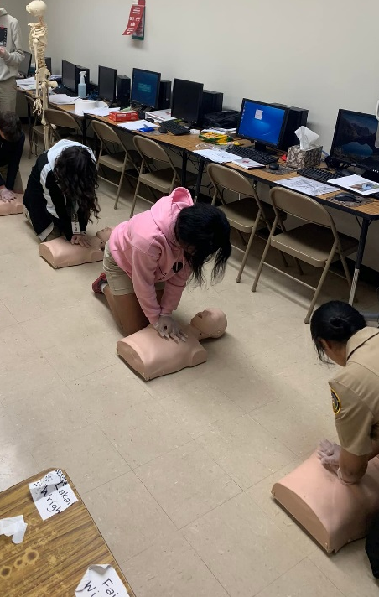
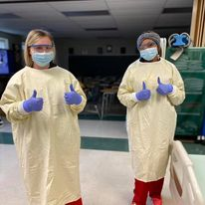
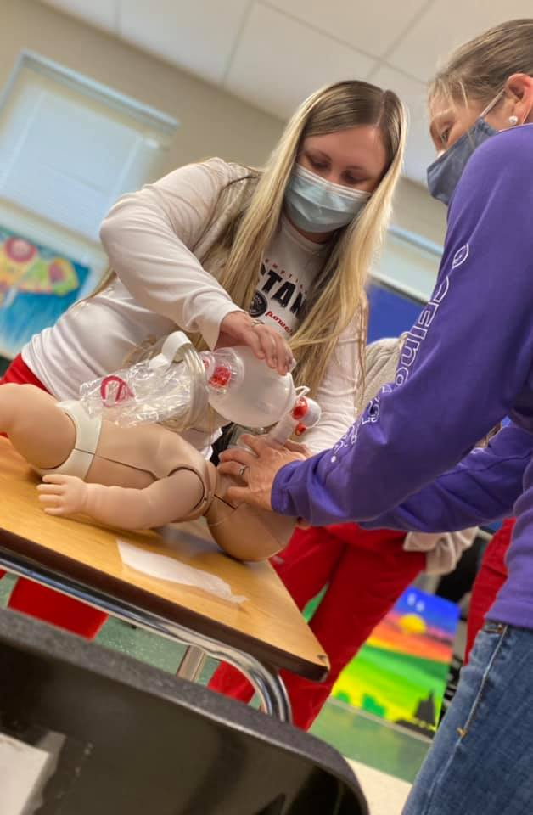
Step 4: Choose your electives- Intro to Health Oc.
Introduction to Health Occupations gives the student the knowledge that all health care workers must learn before entering a health care occupation. This course is recommended to any student considering an occupation in the healthcare field. Students that will enroll in Medical Terminology and Patient Care Technician (PCT) courses must begin with this course.
Academic institution promoting High expectations resulting in Successful students
Students can earn EKG Tech, Phlebotomy Tech, and PCT certifications upon completion of this series of courses.
Assumption High School

Slide 21
Step 4: Choose your electives- General
Cyber Society -Students will explore US laws related to technology, intellectual property, their personal lives, and the ongoing debate between privacy versus security.
Quest for Success - innovative, high school-level, career exploration course designed to prepare Louisiana graduates for career and life success.
Study Skills- Student that have an IEP can take this class for additional academic support.
For a list of electives available in 10th – 12th grade, please visit
https://assumptionguidance.weebly.com/scheduling-information.html .
Academic institution promoting High expectations resulting in Successful students
Assumption High School

Slide 22
Step 5: Pathway Selection
Please select the pathway that you believe your child will be on. This is not an official declaration, but will help us to advise your child. If you are unsure, please select the last option. Remember, we will provide more information next year on pathways.
Sign and return completed schedule proposals to your school office by Thursday, April 6, 2023.
Academic institution promoting High expectations resulting in Successful students
Assumption High School

Slide 23
Registration Process:
Students enrolled at Belle Rose Middle, Labadieville Middle, Napoleonville Middle, and Pierre Part Elementary are automatically registered at AHS. No further registration information is needed. All records are forwarded to AHS from the middle schools on the last day of school. If you are transferring to a school other than AHS for 9th grade, you must complete drop paperwork at AHS.
Students at St. Elizabeth School or any state approved non-public school may pick up registration packets today. Please complete the registration packet and turn it in with your required documents and schedule proposal by Thursday, April 6, 2023. You may bring your registration documents directly to the AHS Guidance Department. Registrations not received by this date will not be accepted until regular registration in July.
Students enrolling from home study, programs that are not state approved, or transferring from public schools outside of Assumption Parish must pick up a registration packet and schedule proposal from the AHS guidance office during regular registration, July 24-27, 2023.
Students that have not taken the 8th grade LEAP will take a placement test. The test will be given on Aug. 8th, 9th, 10th, or 11th. An exact date will be given at a later date.
Required Registration Documents:
Birth Certificate, Social Security Card, custody papers if applicable, and Proof of Residency in Assumption Parish (current service bill, i.e. gas, electric, water, cable). Documentation of successful completion of 8th grade and educational records will be requested by AHS at the time of registration from the previous school.
Academic institution promoting High expectations resulting in Successful students
Assumption High School

Slide 24
What’s next?
Monitor AHS Facebook and our website for announcements and updates throughout the summer.
Freshman Orientation – During the week of August 7th (Exact Date TBD)
Schedule pickup, Chromebook checkout & tours
Supply lists – given on first day of school – bring basics on first day
Note: Students must use school issued Chromebooks. Personal Chromebooks/laptops are not allowed.
First Day of School – August 11th
Freshman class meetings with counselors - Early Fall Semester
Freshman individual meetings with counselors – End of Fall Semester
Updates and information will be provided throughout the year via Google Classroom.
We are only an email or call away if you need anything.
Academic institution promoting High expectations resulting in Successful students
Assumption High School

Slide 25
Presentation Material
This presentation will be posted on our website, www.assumptionguidance.weebly.com
under the “SCHEDULING” tab.
Academic institution promoting High expectations resulting in Successful students
Assumption High School

Slide 26
Support Contacts Assumption High School (985) 369-2956 https://www.facebook.com/AHSMightyMustangs/ www.assumptionguidance.weebly.com
Administrators:
Jessica Thibodeaux, AHS Principal
jthibodeaux@assumptionschools.com
Iris Breaux, Assistant Principal
ibreaux@assumptionschools.com
Debby Landry, Assistant Principal
dlandry@assumptionschools.com
Kay Turner, Associate Assistant Principal
kturner@assumptionschools.com
Heath Zeringue, Assistant Principal
hzeringue@assumptionschools.com
School Counselors:
- Alyssa Aysenne, A-D Counselor -
aaysenne@assumptionschools.com
- Shannon Bayham, E-M Counselor -
sbayham@assumptionschools.com
Erin Theriot, N-Z Counselor –
etheriot@assumptionschools.com
Mrs. Honey, Guidance Secretary- ycaballero@assumptionschools.com
Guidance email (all counselors & secretary): ahsguidance@assumptionschools.com
Academic institution promoting High expectations resulting in Successful students
Assumption High School

