Slide 1
A
Assumption High School
10th Grade Parent Night
Class of 2020
September 14, 2017

Slide 2
Topics
Graduation Pathways/Requirements
TOPS
Grade Promotion
Testing
Sophomore Individual Planning
Academic institution promoting High expectations resulting in Successful students
Assumption High School

Slide 3
Louisiana High School Graduation Requirements (C/O 2018, 2019, 2020)
Identifying an appropriate individualized student graduation pathway is a critical step at the end of the 10th grade year. Students can participate in one or both pathways, TOPS University or Jump Start TOPS Tech. Both pathways help students prepare for postsecondary success and gain access to scholarships.
Students selecting the TOPS University Pathway will continue to pursue core academic credits that mirror the TOPS Core curriculum. Students planning on attending a 4-year college or University should pursue the TOPS University Pathway. Students graduating on the TOPS University Pathway may also complete Jump Start courses as electives and earn an industry credential.
Students pursuing the Jump Start TOPS Tech Pathway may earn basic or advanced credentials in statewide or regional career areas. Students planning on attending a 2-year community college, technical school, vo-tech program, or enter the workforce should pursue the Jump Start TOPS Tech Pathway. Students graduating with a Jump Start TOPS Tech Career Diploma will be required to attain Jump Start statewide or regional credentials. Through elective coursework students may also earn the TOPS University credential.
Academic institution promoting High expectations resulting in Successful students
Assumption High School

Slide 4
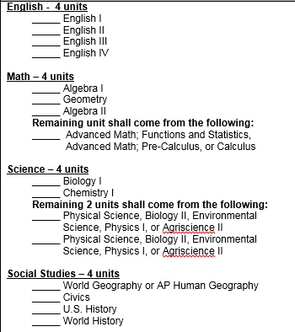
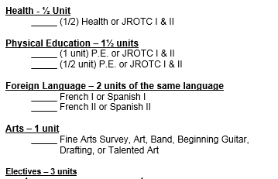
TOPS University Diploma (Required for admission into a 4-year University)
Academic institution promoting High expectations resulting in Successful students
Assumption High School

Slide 5
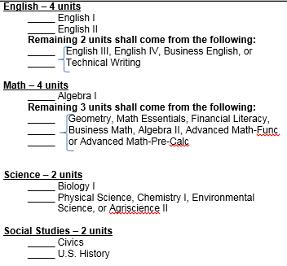
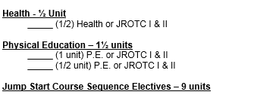
Jumpstart TOPS Tech Diploma
Academic institution promoting High expectations resulting in Successful students
**Reminder: This pathway will allow students to enter into a 2 year community college or vocational program. Upon achieving an approved Associate’s Degree, the student can then enter into a 4 Year University. **
Assumption High School

Slide 6
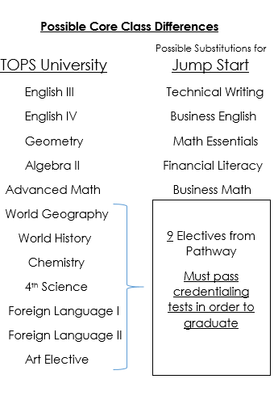
Academic institution promoting High expectations resulting in Successful students
(APPENDIX A)
Assumption High School

Slide 7
AHS Jumpstart Career Pathways
Manufacturing, Construction, Crafts, Logistics:
Carpenter
Electrician
Welder
Certified Nursing Assistant
Hospitality, Tourism, Culinary, and Retail
Business Management
Public Service
Academic institution promoting High expectations resulting in Successful students
Assumption High School

Slide 8
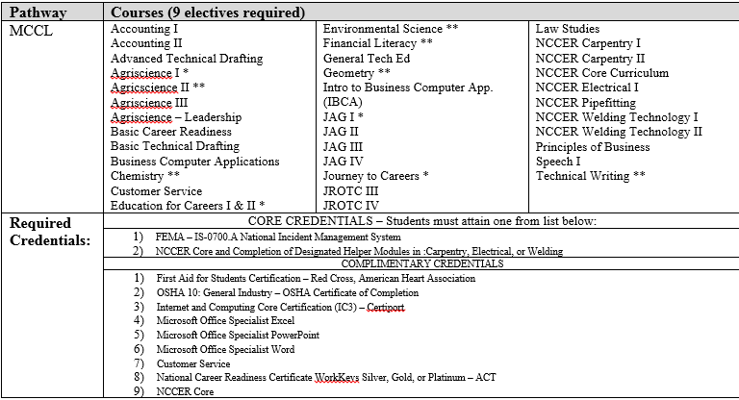
AHS Jumpstart Career Pathways
Academic institution promoting High expectations resulting in Successful students
Assumption High School

Slide 9
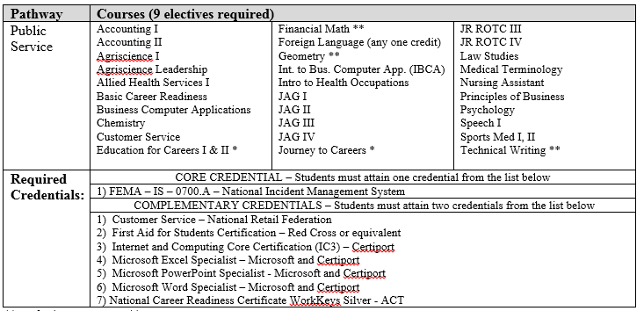
AHS Jumpstart Career Pathways
Academic institution promoting High expectations resulting in Successful students
Assumption High School

Slide 10
Sample AHS Jumpstart Career Pathways
Along with passing the 23 credits required for graduation, the student must pass a series of credentialing tests.
NCCER Pathways:
Must attain NCCER Core ( Given in Agriscience I or General Tech)
Must also attain a NCCER Level 1 Certification in Welding, Carpentry, Electricity, or Pipefitting.
Public Service
Must attain the FEMA Credential ( Given in Civics)
Must also attain 2 of the following:
First Aid CPR
IC3 (Given in computer courses)
Microsoft Specialist in Excel, Word, or PowerPoint (IBCA/BCA)
Silver, Gold, or Platinum on ACT WorkKeys
Academic institution promoting High expectations resulting in Successful students
Assumption High School

Slide 11
TOPS
The TOPS University Diploma requirements also fulfill the core curriculum requirements for the TOPS award!
TOPS is a scholarship that pays for college tuition and can be used at any public University in the state of Louisiana for up to 4 years (8 semesters). The TOPS scholarship can also be used to pay a portion of tuition at private/independent colleges and universities in the state of Louisiana.
Academic institution promoting High expectations resulting in Successful students
There are 3 different award levels of TOPS based on student achievement:
OPPORTUNITY:
Core course GPA : 2.5
ACT score : 20+
(basic tuition)
PERFORMANCE:
Core course GPA : 3.0
ACT score : 23+
(basic tuition + $400/year stipend)
HONORS:
Core course GPA : 3.0
ACT score : 27+
(basic tuition + $800/year stipend)
**For the most up to date information on TOPS funding and legislative updates, visit www.osfa.state.la.us/ **
Assumption High School

Slide 12
TOPS Tech
The Jumpstart TOPS Tech Diploma requirements also fulfill the core curriculum requirements for the TOPS Tech award!
(TOPS University Diploma requirements can also be used to fulfill the requirements for the TOPS Tech award)
Academic institution promoting High expectations resulting in Successful students
TOPS Tech is a scholarship that pays for tuition for up to 2 years (4 semesters) at approved Louisiana Technical Schools, Community Colleges, and Proprietary Schools that offer technical (non-academic) programs.
Requirements:
Core GPA : 2.5
ACT : 17+ or WorkKeys Silver
**For updates regarding Jump Start and TOPS Tech, Text “JUMPSTART” to 99008**
Assumption High School

Slide 13
LEAP 2025(Former End of Course Exam – EOC)
Along with completing either the TOPS University Diploma or the Jumpstart TOPS Tech Diploma, students must also pass End of Course Exams (EOC) in order to graduate!
EOCs also factor into 20% of a student’s final grade in that course.
Students must pass 3 EOCs from the following
(1 from each category):
- English II or English III -
- Algebra I or Geometry -
Biology I or US History -
Achievement levels: Excellent, Good, Fair, Needs Improvement
Academic institution promoting High expectations resulting in Successful students
Assumption High School

Slide 14
Grade Promotion
Students are promoted based on the number of units they earn each school year
Freshman: 0 – 5 units
Sophomore: 6 – 11 units
Junior: 12 – 17 units
Senior: 18+ units
*** Number of units alone does not indicate if a student is on track to graduate.***
Academic institution promoting High expectations resulting in Successful students
Assumption High School

Slide 15
Individual Planning
Twice a year (Fall/Spring)
Fall Meeting –
Update Individual Graduation Plan
Must be signed by a parent!!
Give TOPS/College Information
Graduation Checklist/Transcript Review
Pathway Selection ---Parent must be present to transition to JumpStart!
Spring Meeting-
2018-19 Scheduling
Academic institution promoting High expectations resulting in Successful students
Assumption High School

Slide 16
Guidance Department Website:
http://assumptionguidance.weebly.com/
Academic institution promoting High expectations resulting in Successful students
Assumption High School

Slide 17
Exit Card
Please fill out:
Your Child’s Name
Your Name
Phone Number
Email Address
Choose what path you see your child pursuing.
Finally, tell us what you see your child doing after high school (Example: attending a university for nursing, going to a community college for electrical, ultrasound tech, or going complete on the job training to be a welder……..)
Academic institution promoting High expectations resulting in Successful students
Assumption High School

Slide 18
Support Contacts
Administrators
- Niles Riche, Principal
nriche@assumptionschools.com
- Jessica Thibodeaux, 9th Grade Principal
jthibodeaux@assumptionschools.com
- Debby Landry, Assistant Principal
dlandry@assumptionschools.com
- Heath Zeringue, Assistant Principal
hzeringue@assumptionschools.com
-Jenee Blanco, Administrative Assistant
jblanco@assumptionschools.com
Counselors
- Alyssa Aysenne, A-D Counselor
aaysenne@assumptionschools.com
- Shannon Bayham, E-M Counselor
sbayham@assumptionschools.com
Erin Theriot, N-Z Counselor
etheriot@assumptionschools.com
Academic institution promoting High expectations resulting in Successful students
Assumption High School

